Slide 1
COURSE CONTENT
Exception Handling
Error & Exception
Checked/Unchecked Exception
Try-Catch Block
Finally Block
Throws and Throw
Collection Framework
List
Queue
Set
Map
Collections
Generics
Basics of Java
Introduction & History
JDK,JRE & JVM
Installation of JDK
Compilation & Execution
First Program
Variables
Functions
Loops
Conditions & Statements
Static & Non-static
Constructor
Overloading
Blocks
OOP’s
Inheritance
Abstraction
Interface
Typecasting
Polymorphism
Package
Encapsulation
Array
Predefined classes
String
System
Scanner
Wrapper
Date

Slide 2
Where is Java Used?
According to sun , 3 billion devices runs java.
There are many devices where java is currently used.
  Desktop Applications – Acrobat reader, Media Player, Antiviruses etc.
  Web Applications – irctc.co.in, javatpoint.com etc.
  Enterprise Application – Banking Application, Business Application.
  Mobile
  Embedded systems
  Games
  Robotics

Slide 3
Features of Java
Here is some important features of Java:
It is one of the easy to use programming language to learn.
WORA( Write once run anywhere).
Java is a platform independent. Some program developed in one machine can be executed in another machine.
It is designed for building object oriented application.
It is multithreaded language with automatic memory management.
It is created for the distributed environment of the internet.
Secured – Java does not support pointer so your code is secure. It run inside the virtual machine not directly on O.S. Byte code verifier is there before sending code to JVM.
Robust- English meaning of robust is strong, so strong memory management provided(Automatic garbage collection).
High Performance.
Dynamic – Dynamic language. Supports dynamic loading of class i.e classes loads on demand.

Slide 4
-JDK 1.0 was released on January 23, 1996.
-Each new version adds new features in Java.
-Since Java SE 8 release, the Oracle corporation follows a pattern in which every even version is release in March month and an odd version released in September month.
Java Version History
JDK Alpha and Beta 1995
JDK 1.0 23rd Jan 1996
JDK 1.1 19th Feb 1997
J2SE 1.2 8th Dec 1998
J2SE 1.3 8th May 2000
J2SE 1.4 6th Feb 2002
J2SE 5.0 30th Sep 2004
Java SE 6 11th Dec 2006
Java SE 7 28th July 2011
Java SE 8 18th Mar 2014
Java SE 9 21st Sep 2017
Java SE 10 20th Mar 2018
Java SE 11 September 2018
Java SE 12 March 2019
Java SE 13 September 2019
Java SE 14 Mar 2020
Java SE 15 September 2020
Java SE 16 Mar 2021
Java SE 17 September 2021
Java SE 18 to be released by March 2022

Slide 5
Different Types of Java Platforms
1.Java SE (Java Standard Edition) :
-It is a Java programming platform. It includes Java programming APIs such as java.lang, java.io, java.net, java.util, java.sql, java.math etc. b. It includes core topics like OOPs, String, Regex, Exception, Inner classes, Multithreading, I/O Stream, Networking, AWT, Swing, Reflection, Collection, etc.
2. Java EE (Java Enterprise Edition):
- It is an enterprise platform that is mainly used to develop web and enterprise applications. d. It is built on top of the Java SE platform. It includes topics like Servlet, JSP, Web Services, EJB, JPA, etc.
3. Java ME (Java Micro Edition) :
-It is a micro platform that is dedicated to mobile applications.
4. Java Fx :
-JavaFx is a platform for developing rich internet applications using a lightweight user-interface API.

Slide 6
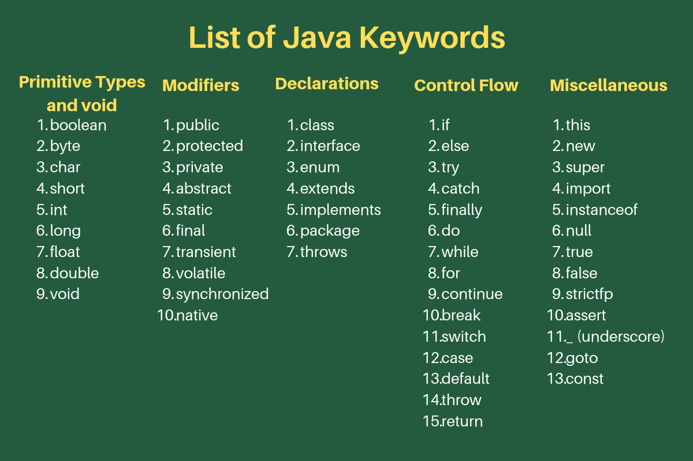
Java Keywords

Slide 7
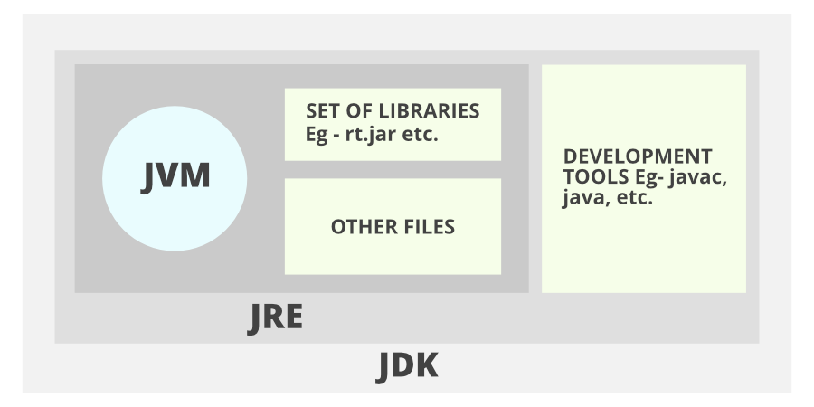
JVM, JRE, JDK ??

